Slide 1
Odoo Upgrade - Progress Reporting
July [19 to 23]

Slide 2

Overview

Slide 3
Overview
Project Documents and References:
Project Plan link:
https://docs.google.com/spreadsheets/d/18ZDAdHBzsEPdpr6rOwJDw2ViElgeVGW-ovWh-N8FheQ/edit?usp=sharing
Functional Test cases document:
https://docs.google.com/spreadsheets/d/12t1AjhoWo4CEOnC9snuApc7Y9-KMogo06I3qzkV-VHQ/edit?usp=sharing
UAT and Complete QA planning:
https://docs.google.com/spreadsheets/d/1zogqMJEMYcj1Ipb8xfOZKy1jcYYzcgeYiMnl-DUolIM/edit?usp=sharing
General action Items tracking sheet: https://docs.google.com/spreadsheets/d/1CQK9vK6pHrssCAB1glM9QhZQiUsD6ni9HpDKusIilDs/edit?usp=sharing

Slide 4
Progress Report -July [19 - 23]

Slide 5
Progress Report Summary - July [19 to 23]
Week Highlights:
Modules Migration [By Verts Team]
Saarus:
Completed the Saarus modules migration to the Version 14.
Feature-wise Demo is in Progress. Once done we can consider the milestone as completed.
Data Migration in progress able to create some of the scripts, which verts team will demonstrate next week [July 27,2021]
KNK:
Completed the Migration of of KNK Finance Modules and the dependent modules. [No progress for last 1 weeks]
Next Week Plan and Highlights: [July 26 -30]
Modules Migration [By Verts Team]
Saarus:
Complete the demo of the Saarus Functionality and start deploying the code on the Saarus UAT server.
KNK:
Start the demo for the KNK Finance feature.

Slide 6
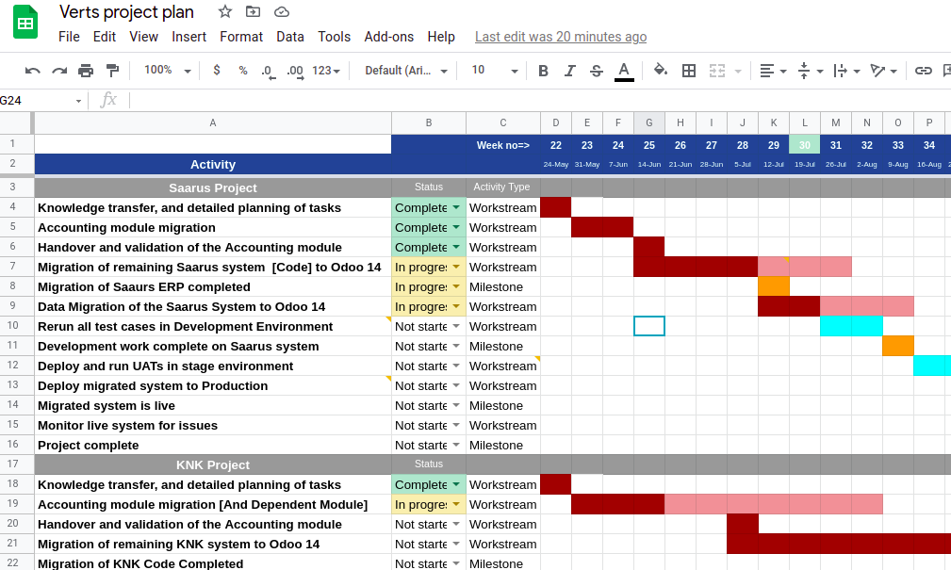
Progress Report Summary - July [19 to 23]
Shows Delay in the timeline

Slide 7
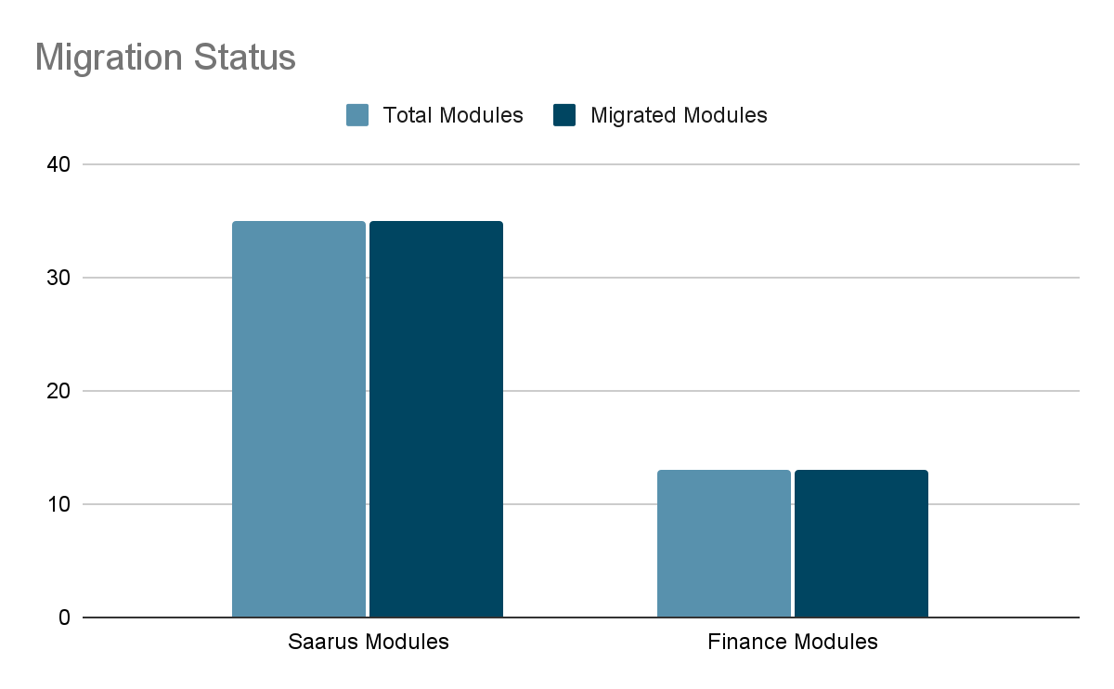
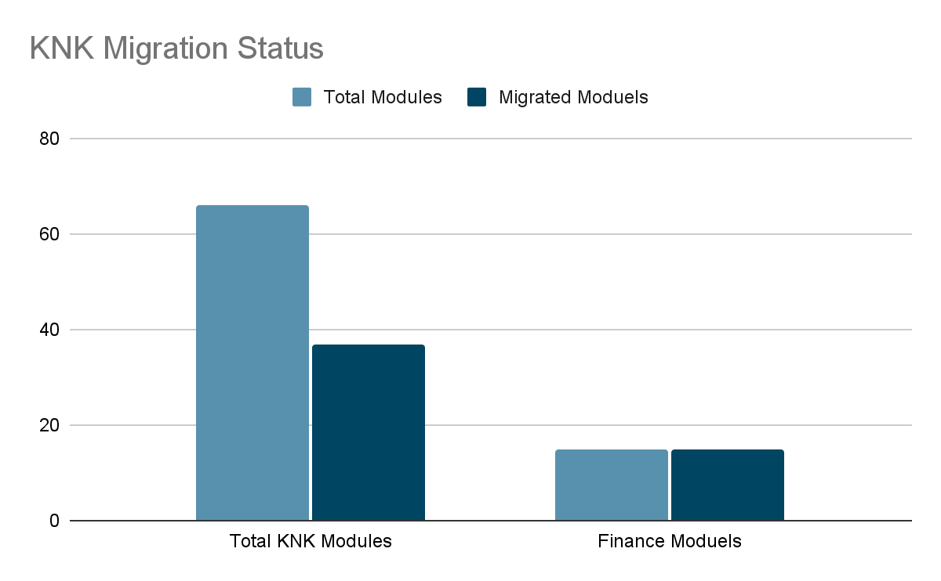
Progress Analysis
Saarus Code Migration Status
KNK Code Migration Status

Slide 8
Risks and Issue
Considerable delay in the milestone in the project deadline.
Parallel project execution is not happening as Verts promised at the time of agreement. As we have not seen any logical progress on KNK side in couple of weeks.

Slide 9
Madhav Agarwal / Siddique Momin
m.agarwal@kokonetworks.com , s.momin@kokonetworks.com

